Slide 1
Crisis Standards of Care Workshop Overview Central Minnesota November 17th, 2017
Notes:
This presentation will provide a brief overview of crisis standards of care at the beginning of the workshop. It is designed to be delivered by a content expert who is familiar with CSC principles and practices and can confidently address questions that arise from the material.

Slide 2
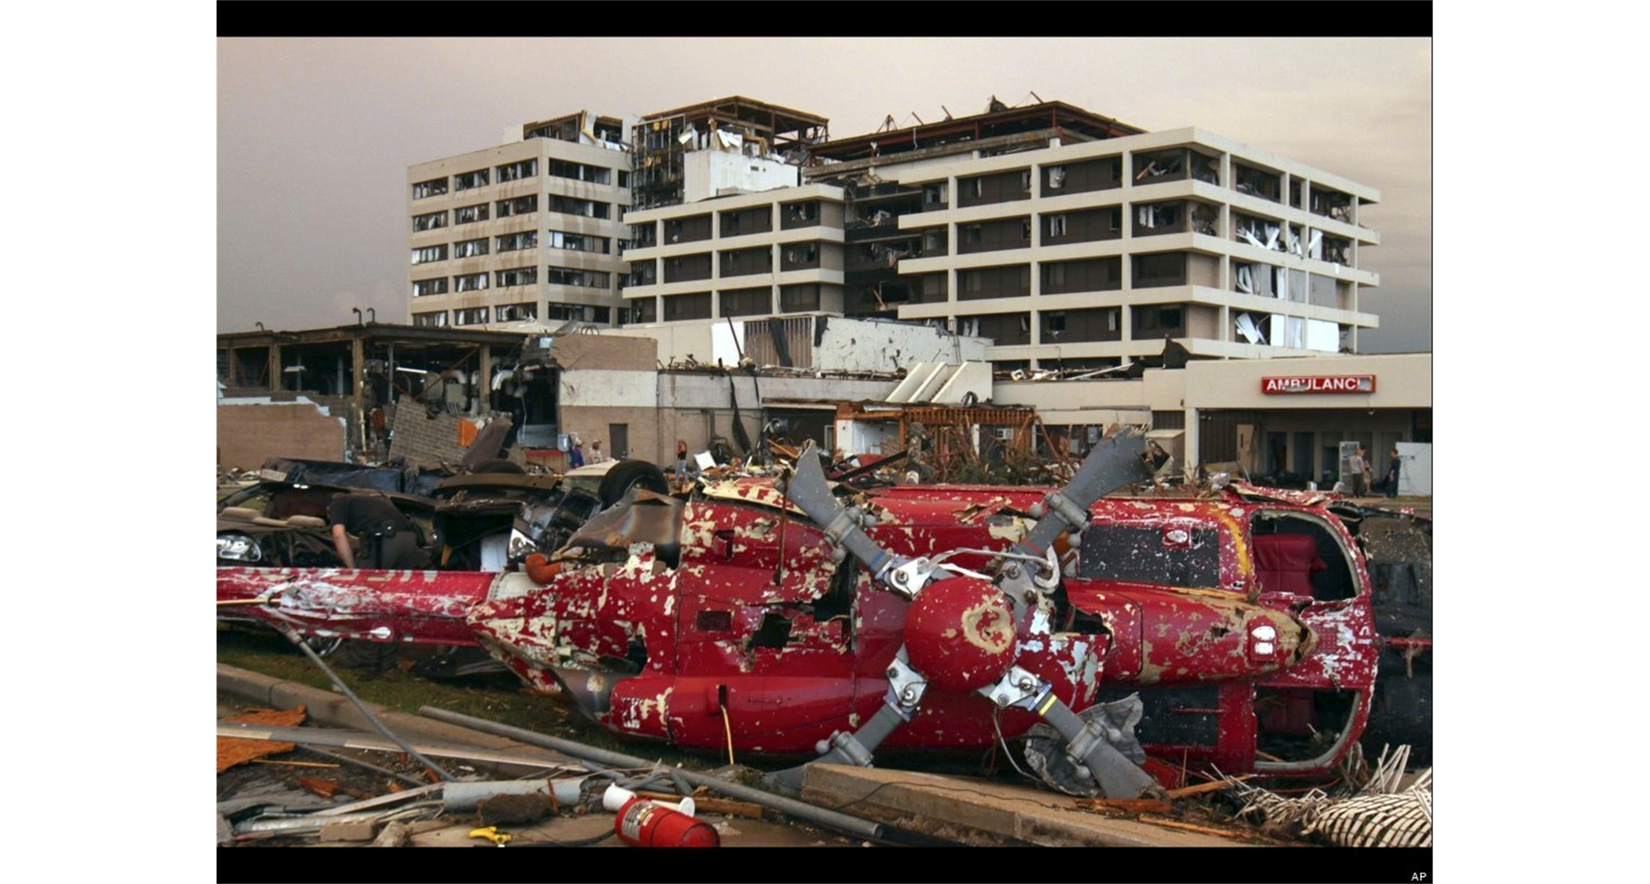
What does Crisis Standards of care look like?
Notes:
What are the challenges here? – discuss – both the damage to the facility rendering it unsafe AND the victims that will continue to present from the community with injury and illness.
Crisis standards of care can occur under many circumstances. Basically, it’s a situation in which you are unable to provide care that is equivalent to usual practices due to excess demands, or a lack of resources (in this case, severely damaged infrastructure combined with demand from the community)

Slide 3
Overarching Goal
Do the greatest good for the greatest number of persons you can, based upon the resources available…
Notes:
This is a shift from our usual focus on the individual, and their desires and needs to the community, and the overall needs.

Slide 4
How to do the greatest good…
Implement incident management and surge capacity plans
Anticipate resource shortfalls
Solve the imbalance (look towards community/coalitions)
Bring in resources
Transfer patients
Triage resources
Get help…
COALITIONS /
COMMUNITY
Notes:
Instructor may ask students what about incident management is important when resources are scarce?
Incident management is critical to providing fair and equitable care – having incident management in place should assure a structured response that is backed by the facility/agency that ensures information sharing and situational awareness, coordination with the healthcare coalition and other partners, and management by objectives using operational periods that adapt care to the current situation, attempt to solve the problem, and adjust according to dynamic environments (proportional response). Key strategies are listed to solve the problem – note that some situations will resolve rapidly with influx of resources or transfer of patients (e.g. mass casualty event in a small community) and some will not (e.g. pandemic)

Slide 5
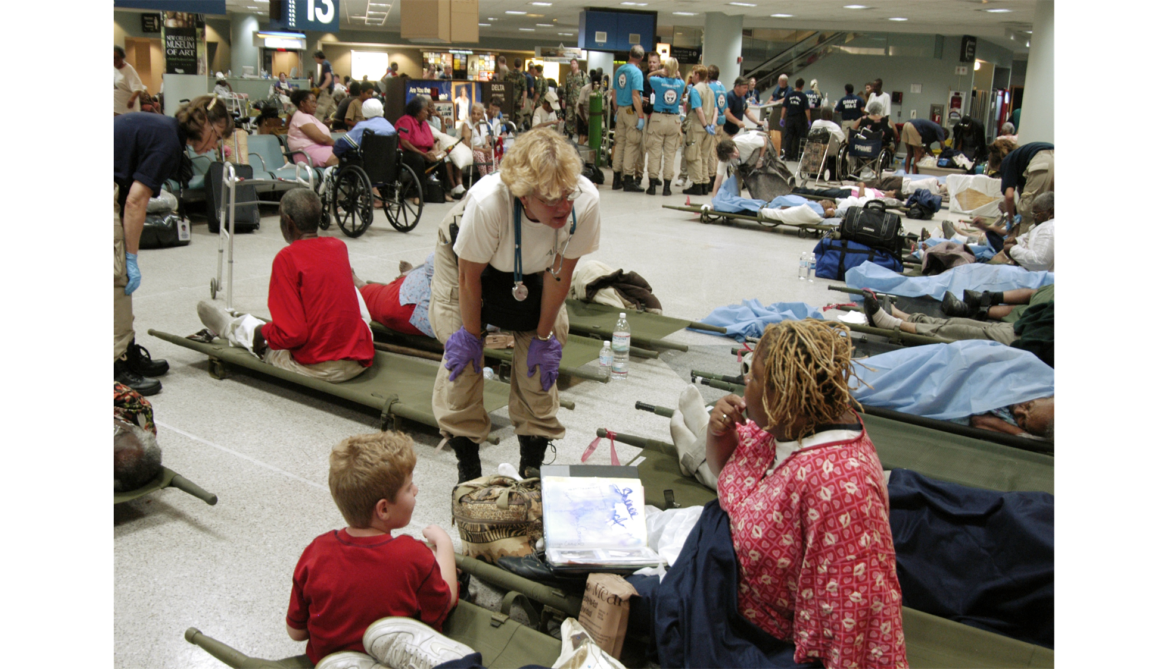
Notes:
Louis Armstrong Airport – New Orleans, LA after Hurricane Katrina – important issue here is that the DMAT teams initially had to ‘black tag’ numerous people because they did not have the resources to care for them – but only a few of those patients actually died because the team re-triaged the patients as more resources arrived and additional airlift capacity became available – disasters are dynamic, and care strategies and triage must be re-evaluated as the situation changes.

Slide 6
Influenza
Moderate influenza pandemic would exhaust critical care resources throughout the state, likely including ventilators
ECMO (extracorporeal membrane oxygenation) is being used more and more for refractory ventilatory failure
Anti-virals and vaccine are in short supply
General medications and supplies are in short supply
PPE shortages have been frequent and severe
Alternate care systems have provided critical past support for traditional systems (2009)
Notes:
There are many scenarios under which resources will be insufficient for a prolonged period of time, and state-level actions may be required to promote consistent strategies and support non-traditional responses (e.g. alternate care sites or systems such as the telephone prescribing lines used during 2009 H1N1). One of the most likely scenarios for a crisis standards of care situation would be a pandemic.

Slide 7
2012 - IOM
Notes:
The 2012 IOM (now National Academies of Medicine) Crisis Standards of Care document contains sections for each of the core coalition members (hospitals, EMS, EM, and PH). Perhaps most valuable are the tables at the end of each section that illustrate key functions and tasks for CSC planning that are tied to sections of the text.

Slide 8
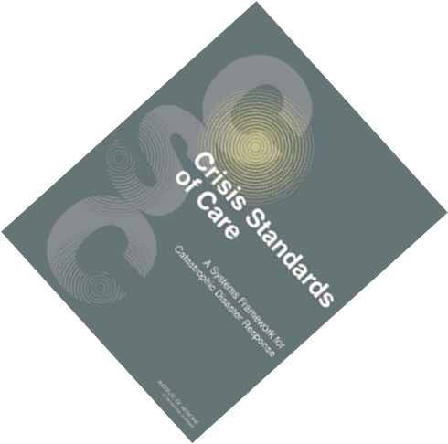
Notes:
It’s not expected that you read the IOM report cover-to-cover – but there’s a LOT of excellent and operational information in there for each discipline that’s worth looking at

Slide 9
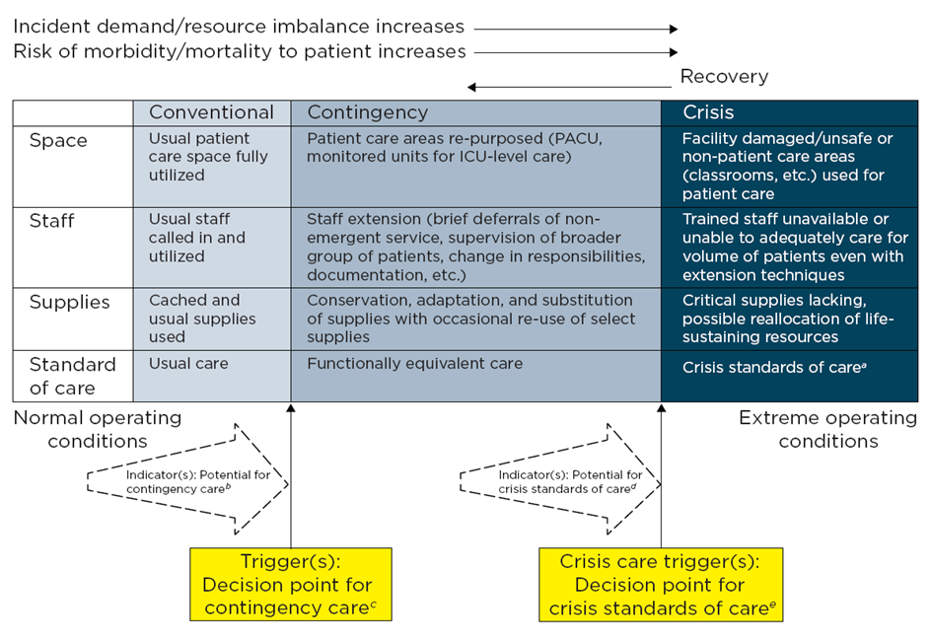
Continuum of Disaster Care
Notes:
Many of you may be familiar with this construct. Conventional care is on the left in white – that’s our default, and what we want to get back to as soon as possible. Contingency care in yellow provides functionally equivalent care (e.g. caring for patients in PACU / same day surgery areas if there’s no beds) that doesn’t really risk a bad outcome. Crisis care, on the other hand, in red on the right, is a situation where resources are inadequate and we have to make choices knowing that some patients may have poor outcomes as we try to meet the demands of the community as a whole

Slide 10
What is crisis care?
Crisis standards of care – systems response including formal government recognition of situation – prolonged event
Crisis care – situational – inadequate resources – must provide ‘best care possible’ given the situation despite some risks to the patient(s) – much more common
Notes:
We do need to draw a distinction between crisis standards of care and crisis care. Crisis standards of care are system responses during a prolonged event and involve governmental efforts to support the response and promote consistency across the affected region. Crisis care is very situational and may last for hours or days – there’s no government involvement and likely no formal declarations – healthcare coalitions can often address these situations within hours – examples might include a mass casualty event in a small community that temporarily overwhelms the local hospital, or a drug shortage (saline, sodium bicarbonate, etc.)

Slide 11
Key Points
Part of the surge capacity / disaster plan
Don’t improvise! – practical and liability issues
Dynamic situation – flux between contingency/crisis
Proportionality
Crisis care will happen regardless of official actions
Triage – RARE – most crisis care will involve staffing and bed issues
Don’t be an island! Use Coalition Support…
Notes:
Crisis care plans should be extensions of the disaster plan in every facility and agency – NOT a separate plan
Decision-making during a crisis is not going to be pretty ( may ask if anybody’s read 5 days at memorial) – so try to have guidelines in place and processes in place
Try to get back to contingency as soon as you can but recognize the situation is going to be dynamic and could worsen again
Don’t be more restrictive or aggressive with triage than you have to be – only make the changes you have to – just because you don’t have a certain drug doesn’t mean you can’t do other things to benefit the patient.
Agencies/hospitals don’t have the option to implement crisis care – it will just happen, and you’ll have to react – if you can’t solve it regionally, crisis standards of care may have to be implemented
Triaging of resources such as ventilators or other dramatic actions is NOT common – most crisis situations will involve a lack of ambulances, beds, or staff
SOLVE the problem – make sure you have plans to fix the issue through your coalition – get resources in, get patients out – and if you can’t fix it then figure out how the coalition can promote consistency in the area

Slide 12
MDH CSC FRAMEWORK
CSC Framework
Roles and Responsibilities
Summary of contributing entities
Ethics
EMS
Hospitals
Public Engagement
Decision support tool - MDH SAT cardset
Notes:
The MDH CSC framework is designed to overview the state-level actions as well as provide operational guidance through a series of addendums including ethics, EMS, hospitals, and public engagement. Traditionally, these might be called annexes, but as the CSC Framework is an annex to the MDH All-Hazards Plan, these are addendums. The previously developed scarce resources cardset is a complementary clinical (rather than system) resource for decision-making. We are going to go through these various addendums of the plan.

Slide 13
Crisis Care Planning
Indicators and Triggers
Incident management
Clinical input
Communications
‘Triage’ decisions (restrictions, etc.) and processes
Quality assurance and reporting
Coalition and other actions to return to conventional status
Notes:
In addition, there are many components that go into a crisis care plan at the agency or facility level. First, there’s an indicator or trigger event that makes us recognize we do not have the resources. When a trigger point is hit, the incident management system should be initiated (if it wasn’t already). Clinical input is important so that the incident managers understand the situation, the potential options for care, and the recommendations (either from the clinicians, or from external guidelines). Communications with patients, staff, and partner facilities needs to be initiated for situational awareness and transparency about the situation and what is being done. Triage decisions may not be overt, but medication use may be restricted for example – these decisions should be structured whenever possible so that there is consistency. These decisions also need to be tracked and analyzed the same way we do quality improvement to assure the processes are consistent and fair, and don’t require adjusting. Finally, the healthcare coalition MUST be engaged to help provide information sharing, and policy and resource sharing support to help mitigate the problem.

Slide 14
Ethics Core Elements
Fairness
Accountability
Transparency
The duty to care
The duty to steward resources
Consistency
Proportionality
Notes:
The CSC Plan was based on a foundation of ethics. MDH hired the MN Center for Healthcare Ethics to help us lead our ethics planning. They also hasd worked on our pandemic planning so we were able to build on our past efforts. Crisis decisions need to be made on an ethical foundation. As described in more detail in the annex here are the key components:
Fairness – across all populations (consider who may be left out!)
Accountability – who is accountable for the decisions?
Transparency – to providers, patients, families, public
Duty to care – not an option – we have to do all that we can do (which means, for example, still providing symptom relief for the dying)
Duty to steward resources – we cannot simply expend resources in a first-come, first-served manner until they are gone if we know that we can have greater benefit by allocating them according to need
Consistency – within and between the affected facilities/agencies – inconsistency is unfair, and creates huge problems for the public and providers
Proportionality – don’t triage what you don’t have to! And when resources allow, re-triage to assure that you are fully using the resources available.

Slide 15
CSC Ethics Workgroup
To discuss and affirm overarching ethical framework to serve as statewide guidance for CSC.
To draft and finalize ethical guidance to be added as supporting documentation for the overarching CSC Plan
MN Center for Healthcare Ethics
RHPCs
Mayo Clinic
Allina Health
Veterans Health Administration
University of MN Health
HCMC
MN Disability Center
MDH
Retired Ethics SME
Notes:
A wide variety of partners formed the Ethics workgroup with these two key outcomes…

Slide 16
Overview of Framework: Fundamental Commitments
Pursue Minnesotans’ common good in ways that:
Are accountable, transparent and worthy of trust;
Promote solidarity and mutual responsibility;
Respond to needs respectfully, fairly, effectively and efficiently

Slide 17
Legal Standard of Care
The care and professional skill usually exercised by the ordinary member of her or his profession in good standing in same or similar circumstance.
Notes:
The Legal annex provides a brief overview of some of the legal issues affected crisis care situations. It’s important to always remember that standards of care are situational – that is, they depend on what a reasonable, ordinary provider would do in a similar situation – and if you are following processes and guidelines developed by reasonable, ordinary providers, you’re going to be in a lot better shape then if you just ‘make it up’ as you go

Slide 18
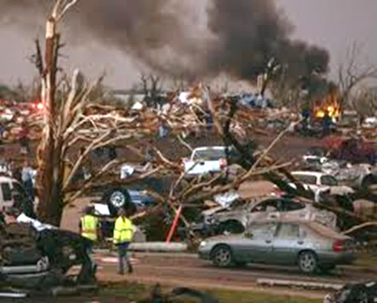
Minnesota Emergency Laws
The Minnesota Emergency Management Act of 1996 (MEMA)
Minnesota Statutes Chapter 12
Notes:
Most of Minnesota’s governmental emergency powers derive from these laws. Note that there is no separate public health emergency declaration in MN. Chapter 12 affords broad powers to the cities and state under emergency declarations.

Slide 19
MEMA – Emergency Declarations, Two types
National Security Emergency:
Information indicates the imminence of a national security emergency within the U.S. or Minnesota of a major disaster from enemy sabotage or other hostile action.
Peacetime Emergency:
Act of nature,
Technological failure or malfunction,
Terrorist incident,
Industrial accident,
Hazardous materials accident, or
Civil disturbance that:
Endangers life or property and local government resources are inadequate to handle the situation.
Notes:
There are 2 types of MEMA Emergency Declarations. Peacetime emergencies include essentially all disasters relevant to our discussions.

Slide 20
EMS
Notes:
The EMS annex provides operational guidance for pre-hospital providers that are very often the first to recognize and have to deal with a disaster situation. Particularly in rural areas, crisis conditions for EMS may occur frequently, though they will usually be addressed within hours.

Slide 21
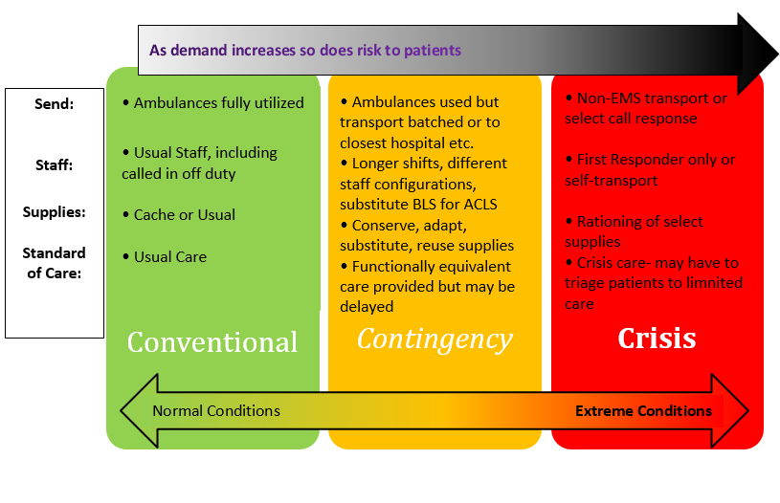
Notes:
For EMS, we modify our table to reflect ‘send’ (the ambulance, or other responder), staff, supplies in a similar format to the previous table. This framework is then used to discuss response options.

Slide 22
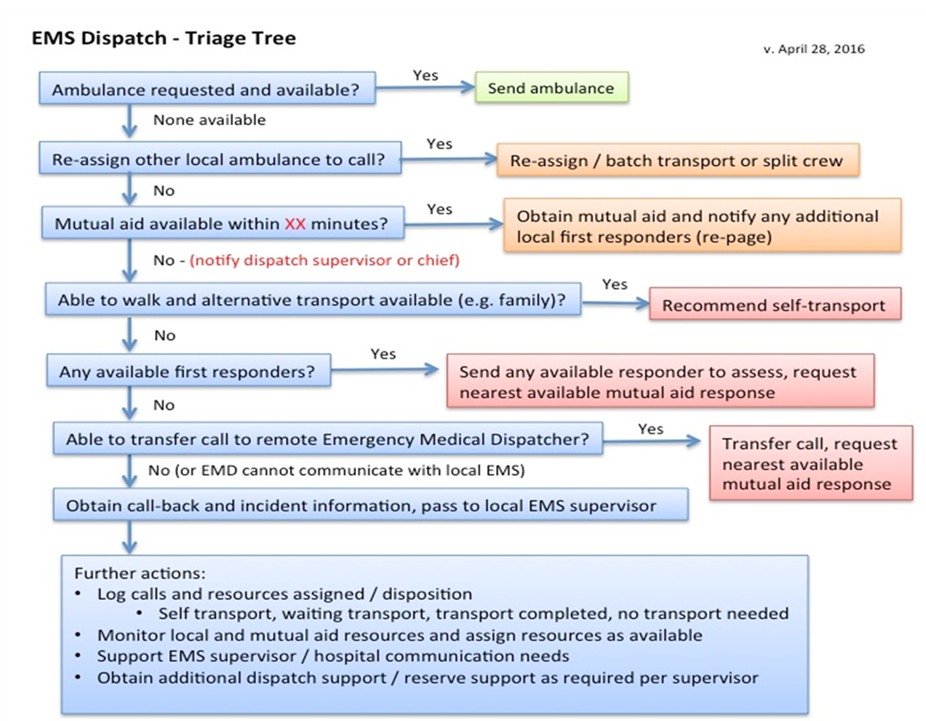
Notes:
For example, if you do not have enough ambulances to address the demand, this algorithm provides options from mutual aid to sending first responders in private vehicles, recommending self-transport, and other options. It’s important that the dispatchers have access to decision tools such as this so that they are not forced to make high consequence decisions on their own without guidance or support.

Slide 23
EMS crisis care plan
Notes:
In certain situations, such as a pandemic, the EMS crew may have broader discretion to leave patients at the scene (no transport) – this is one small section of the Hennepin County Pandemic Plan illustrating crew considerations for bleeding/wounds. Providing guidance to crews whenever possible protects them and the service from excess legal liability and provides confidence to the crew members in their decision-making.

Slide 24
Hospitals
Patient Care: Strategies for Scarce Resources Situations
A standardized framework to assist Minnesota hospitals, clinics or primary care settings in determining how to extend resources when the need for specialized equipment and supplies such as ventilators and pharmaceuticals exceeds availability during a public health emergency
Notes:
The Hospital / healthcare annex provides guidance for hospital planning for crisis situations

Slide 25
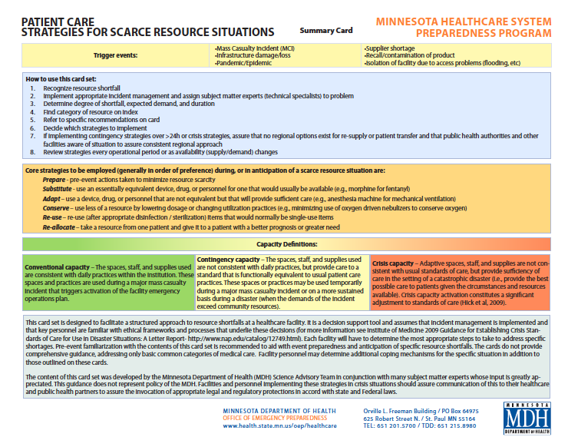
Notes:
The MDH Science Advisory Team (SAT) has developed a clinical cardset over the past several years that you may be familiar with – these are designed to support the processes and strategies contained in the CSC plan

Slide 26
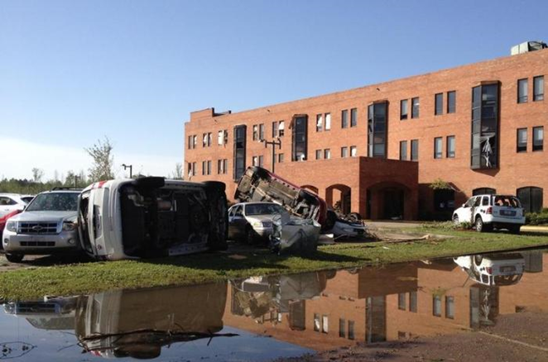
Notes:
Hospitals and healthcare facilities are vulnerable to both excess demand as well as infrastructure (e.g. flooding, as seen here) situations that can force crisis operations at the facility.

Slide 27
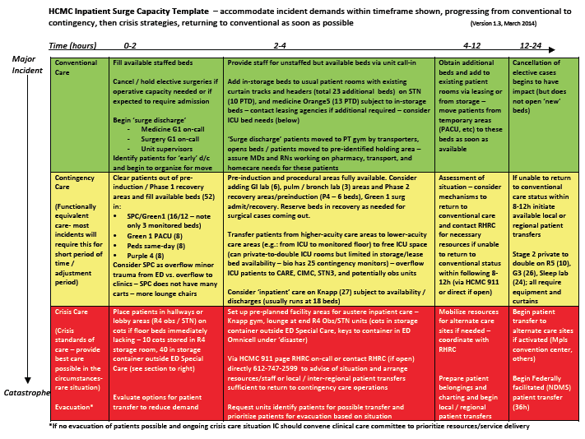
Notes:
Surge capacity plans should include the crisis component – this is a grid that shows space expansion at one facility vs. time (what can be done first/fast in each category) from conventional into crisis care.

Slide 28
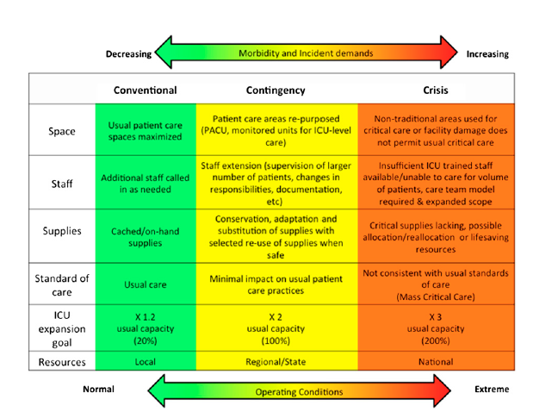
Notes:
Hospitals that provide critical care have additional layers of planning – according to the American College of Chest Physicians recommendations, hospitals should be able to expand ICU capacity 20% right away, 100% over the first 24h (using regional resources) and 200% over days using national resources. Knowing where and how this expansion occurs and exactly what resources are needed is important to help facilitate those resource requests early. Again, this assumes that you cannot transfer patients to meet the demand

Slide 29
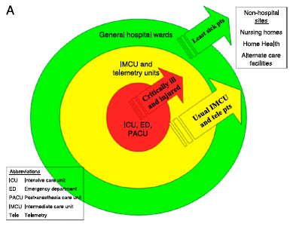
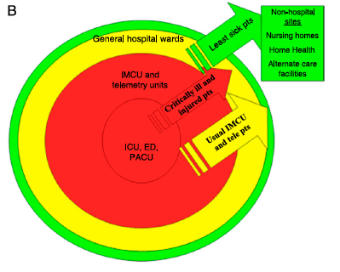
Notes:
So as we expand our critical care capacity within the hospital (and have sicker patients there – as shown by this slide with normal operations at left and crisis at right) patients that would normally be in the hospital have to be moved out to LTC, homecare, and alternate care operations… This obviously has implications for staff and supplies as well, but it also has huge implications for the coalition partners

Slide 30
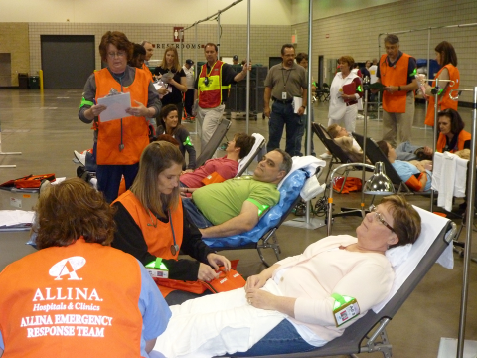
Notes:
Alternate care sites can serve a number of functions from screening to early ambulatory care to overflow inpatient care including provision of oxygen (as shown here during an exercise). Planning for these sites and systems of care is critical to supporting healthcare operations during a crisis and healthcare coalitions bring all the relevant partners for these efforts to the table

Slide 31
“Plans are nothing. Planning is everything.”
-Dwight D. Eisenhower
Notes:
Planning provides the framework that can be tweaked during a response as well as builds the relationships between responders. It also forces consideration of a range of options and discussion of issues that may not be reflected in the plan itself, but will be available to inform the response when one occurs.

Slide 32
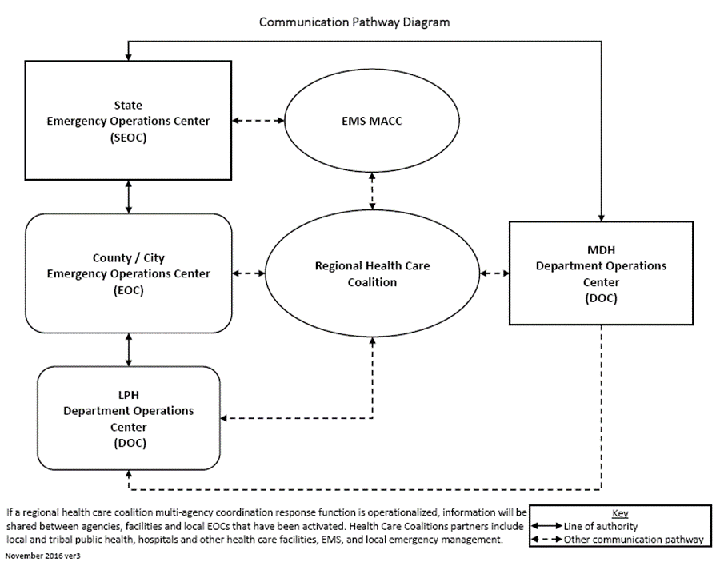
Health Care Coalitions
Notes:
When we talk of planning, we do most of our work of healthcare planning and preparedness through coaltions. Coalitions are critical to the success of crisis responses. By sharing information and providing multi-agency coordination with our partners at the state and local level we can, as a public/private partnership, help diffuse the demand across a broader range of resources or help allocate resources effectively.

Slide 33
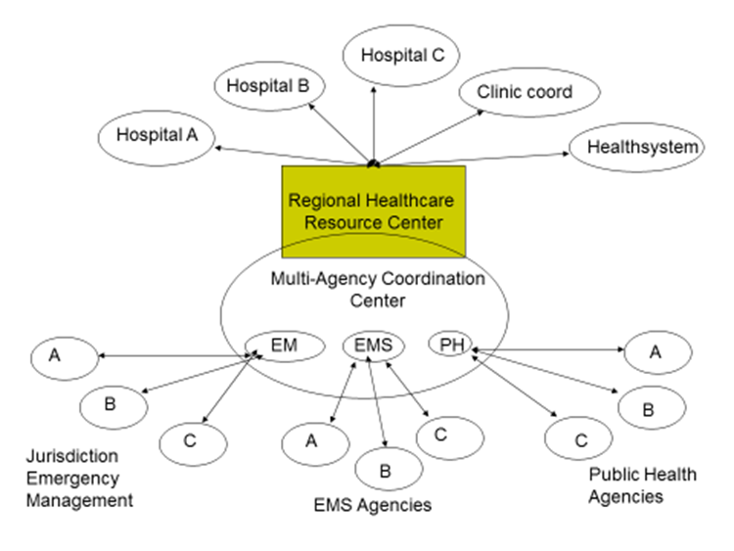
Notes:
This multi-agency coordination can be difficult depending on the number of affected partners – it’s important that public health, EM, EMS and hospitals be coordinated – many actions by one discipline have direct effects on the other – this coordination starts with information sharing…and may involve monitoring of essential elements of information such as beds available, ventilators, or available vaccine.

Slide 34
Coalition Plan
Isolated?
RHRC
RDMAT / SAT
MDH requests
Triage teams
Regional teams
Notes:
Each coalition should have a plan for crisis conditions. This should specify when and how the partners are informed and what coordination actions may be taken. Some of the actions depend on whether or not the issue is isolated (and can be fixed quickly) or prolonged. It may specific RHRC actions (which may be virtual or physical) to coordinate. If there is a regional disaster medical advisory group or subject matter experts, these should be engaged. MDH may be requested to provide SAT or other support. If regional triage / transfer teams are envisioned for a prolonged event in your region these may be detailed as well. Coordination and responsibilities for alternate care sites/systems may also be specified in the plan. Again, there’s not a set expectation, but discussing crisis conditions and mapping out a strategy with partners can be invaluable at working through assumptions and agreeing on common needs.

Slide 35
Hospital Plans
Trigger(s)
Notifications
ICS
Participants
Tools
Process
Communication
Notes:
Hospitals should include crisis care in their surge plan, but may need an annex for decision-making/triage that can include triggers, notifications/authorities, the activation of ICS and engagement of subject matter experts, any reference to tools to be used (such as the MDH cardset), and specifying the process – the who and how… communications to providers and patients/families is a key part of any triage plan – optimally everyone should be aware of the plan before triage decisions have to be made

Slide 36
The road ahead
Coalition engagement
Public engagement
Provider engagement
Agency actions / Facility actions
Exercises
Incorporation into surge plans
Notes:
Crisis care planning is a process. Though we now have a plan and annexes to guide you, it’s up to you, as an agency, facility, coalition, and provider to figure out what you will DO in these situations. The MDH plans public engagement processes as well as looking for opportunities to get information to providers over the next year, however you have the tools to sit down and do the planning – figure out the strategies, the coordination mechanisms, and then exercise them and revise them. In the future, exercises can test elements of these plans as well as general surge plans to keep the information accessible and assure that CSC planning is smoothly integrated, rather than sitting on a state shelf never to be used until the end of the world happens

Slide 37
CSC Timeline
Fall/Winter 2016
Summer 2017
Fall 2017
Develop CSC Steering and workgroups
EMS workgroup met, finished and distributed EMS Framework
Ethics contractor is hired. Ethics workgroup met and Framework is complete
CSC Contractor is hired
Rough Draft of CSC Framework complete.
Distribute CSC Rough Draft to CSC Steering workgroup, obtain comments
Healthcare and Rollout Workgroups met and planned sector specific rollout sessions
Edit the CSC Rough Draft of the CSC Plan
Release CSC Plan
Start public engagement and healthcare rollout sessions
Education and Information Sharing on CSC Plan
Healthcare, EMS and Coalitions work on their CSC Plans
Continuation of Public Engagement and Healthcare/EMS rollout sessions
Hospital, Coalitions and EMS began to work on their CSC Plans.
Presentation of CSC Plan at Conference and Healthcare systems
Spring 2017
Notes:
Here is a provisional timeline for the CSC activities… note that this is not the end of CSC work, but an opportunity to get the plans and guidance in front of our stakeholders – including the public and providers – the ongoing work is getting the concepts and strategies understood and integrated into response planning and exercises over the next several years until it is a seamless part of the response

Slide 38
Conclusion
Crisis situations are relatively common – but often short-lived
Develop practical solutions for your agency / facility
Empower employees to implement
Bite-sized pieces of planning
Engagement of medical directors, administration
Coordination with healthcare coalition
Notes:
Some key concepts that we’ve discussed…
Don’t try to take this on all at once!
Assure that you have the backing of your leadership – both in planning and during response – this is not an individual issue, but a collective one
Coalitions are key to getting out of crisis as fast as possible and, when not possible, providing consistent care

Slide 39
Thank you!
John Hick, HCMC (contractor for MDH CSC Plan)
Hick.john@gmail.com
Erin McLachlan, MDH (project manager)
Erin.McLachlan@state.mn.us
Angie Koch, MDH (ethics)
Angelica.Koch@state.mn.us
Notes:
We hope that this provides you with some ideas and gives you some context for our discussions today. We hope that the materials will be reinforced during our workshop activities, and that those will give you some concrete ideas of issues that you can work on in your home agency or facility.
Take time to address questions and for discussion – some issues and topics you may need to take up with an individual or ask be brought back to the final Q&A after the workshop if they aren’t clarified during those activities if the issue/question is conceptual or a lack of understanding.

