Slide 1
Surviving an Active Threat: A Train-the-Trainer Course
Prepared for the Northwest Minnesota Healthcare Preparedness Coalition
January 8, 2019

Slide 2
Agenda
Introductions and Objectives
ALICE vs. Run, Hide, Fight
Scenarios
Train-the-Trainer

Slide 3
Workshop Instructors
Jenny Schmitz, All Clear
Jeff Kolts, JPK Consulting

Slide 4
Objectives
Teach active threat response techniques for a healthcare setting.
Provide an opportunity for attendees to implement response techniques in a simulated scenario.
Provide attendees with tools and templates to teach the response to an active threat in their facility.

Slide 5
Definition
An “Active Shooter” is:
An individual actively engaged in killing or attempting to kill people in a confined and populated area
In most cases, active shooters use firearm(s)
There is no pattern or method to their selection of victims.
Source: US Department of Homeland Security, 2009

Slide 6
Active Shooters in Hospitals
In Hospitals between 2000-2011:
154 hospital-related shootings
91 (59%) inside hospital building; 63 (41%) on hospital grounds
Emergency Department is 30% of shootings (31 in ED, 13 in Ambulance Bay or parking lot)
138 shootings (91%) had a single male perpetrator
112 (75%) were highly targeted (grudge, suicide, ill relative, or escape attempt)
235 victims
94 (61%) had only one victim
Source: Kelen, et al. Annals of Emerg Med, 2012

Slide 7
Our Goal Today:
“The active aspect inherently implies that both law enforcement personnel and citizens have the potential to affect the outcome of the event based upon their responses.”

Slide 8
ALICE vs. RHF
DISCLAIMER

Slide 9
ALICE vs. Run, Hide, Fight
ALICE
Run, hide, fight
A = Alert
L = Lockdown
I = Inform
C = Counter
E = Evacuate
Run
Hide
Fight

Slide 10
ALERT / INFORM vs. ?
Not included in Run, Hide, Fight
Understand what methods are available and to which staff
Initial Notification and Updated Information

Slide 11
LOCKDOWN vs. HIDE
What does “Lockdown” mean?
How to block your self in a room
Consider:
How does the door swing?
Is there a window?
Does the door lock?
Who has access to the door?

Slide 12
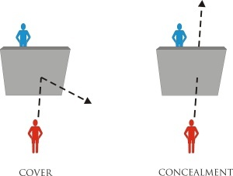
LOCKDOWN vs. HIDE
Cover and Concealment

Slide 15
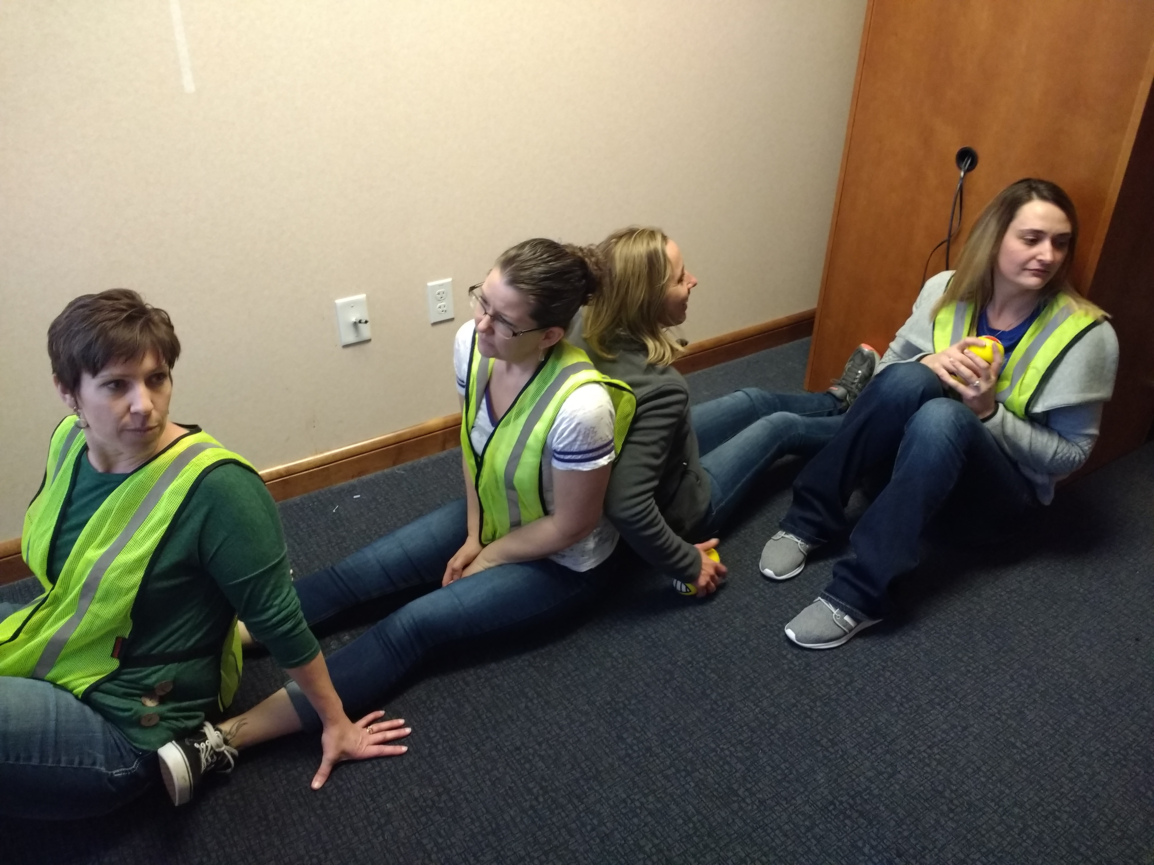

Slide 17
FIGHT vs. COUNTER
Fight
Hands on method
Use weapons around you
Alone or in a group
Counter
Interrupt the process of shooting accurately
Power in numbers

Slide 18
COUNTER: OODA LOOP

