Slide 1
Active Shooter
Tabletop Exercise
[Insert Date]
Notes:
Items in [ ] are for information for the facilitator or information that should be adjusted for each work area.
[A tabletop exercise involves key personnel discussing simulated scenario(s) in an informal setting.]
Introduce yourself.
[During the conduct of the exercise be mindful of psychological safety issues. The exercise should be paused or stopped if any safety concerns arise.]

Slide 2

Agenda
Notes:
2
2
Provide an overview of today’s planned activities and agenda.
Participant Introduction
Exercise Objectives & Expectations
Active Shooter Risk Overview
Scenario
Debrief/Hot Wash
Evaluation
[You can adjust the number of question slides or the item spent on each topic depending on the time available.]

Slide 3
Notes:
Ask participants to introduce themselves (especially if from various work areas).
Name
Area/Department/Agency
Title
“The most challenging activity you ever did” (or other fun trivial question)

Slide 4

Notes:
Introduction: Why are we here? The purpose of the tabletop exercise is:
to provide an opportunity for attendees to participate in facilitated discussions of their roles, responsibilities, and anticipated activities in response to an active shooter scenario
to help the participants better understand roles and responsibilities for response to an event requiring relocation/evacuation,
to help the participants better understand roles and responsibilities for continuity/recovery of services involving an event that prevents occupation of routine work areas,
to provide an opportunity to consider internal and external messaging needs for an event involving an incident involving a significant, violent event.
We will discuss the questions as a group. I will lead the discussion by providing information about what is happening in the scenario and asking general questions. You will have an opportunity to respond to the questions as well as discuss topics freely within an established time frame. The tabletop exercise is intended to stimulate discussion of emergency response and clinical/business continuity actions in response to a hypothetical incident.
4

Slide 5

Notes:
Let the participant know what the specific objectives of the exercise are:
Onsite Incident Management
Identify and enhance security tactics, techniques, and procedures in responding to an active shooter threat within our facility.
Communication/Information Sharing:
Identify current processes, and contingency methods to provide critical information to employees and the public in a timely manner.
Evacuation/Shelter-in-Place:
Execute safe and effective sheltering-in-place of patients, and/or the organized and managed evacuation of building occupants to safe areas in response to a potentially or actually dangerous environment.
Law Enforcement Response
Enhance operations between local law enforcement and staff in combating/responding to threats.
Continuity of Operations:
Identify challenges and available resources to ensure the ability to reconstitute essential functions after a disruption.

Slide 6
Thou shalt…
Learn
Share
Not point fingers
Look for ways to improve
Notes:
Review exercise expectations:
Identify any opportunities for improvement.
This is an open, no-fault, stress-free environment. There is no single “right” response to scenario events. Varying viewpoints, even disagreements, are expected. Each of you is encouraged to openly discuss potential issues and identify ways to resolve them. Please respond on the basis of your knowledge of current response plans and capabilities (i.e., you may use only existing assets) and insights derived from your training.
Assume the scenario and exercise activities are real. If parts of the scenario seem implausible, do not complain. Recognize that the exercise has objectives that must be satisfied and may require doing things that may not be as realistic as we would like.
The tabletop exercise is an opportunity to clarify roles and responsibilities, policies and procedures, and understand capabilities and limitations. It is not a forum for “developing” plans . For discussions that get bogged down with planning details, facilitators will note the issue and will guide the discussion toward a new topic. Any identified planning, training, or exercising need will be documented for inclusion into an after action report and improvement plan.

Slide 7

Notes:
I [or person you ask to take notes] will capture information for inclusion in a formal post-exercise After Action Report. Participants will be asked to complete a feedback form to provide input about identified strengths and opportunities for improvement from their perspective. The information will be included in an After Action Report and Improvement Plan to document lessons learned and drive process improvement. (There is a form that can be downloaded to provide a printed Participant Feedback Form.)
[This information will be entered into the Mayo Clinic Exercise/Incident Documentation and Improvement Tracking (EDIT) Tool]

Slide 8
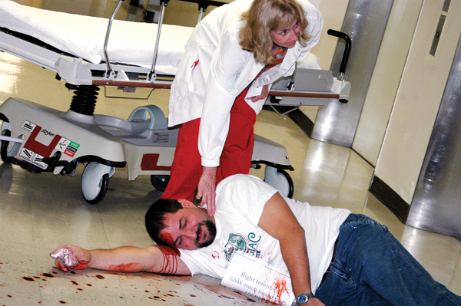
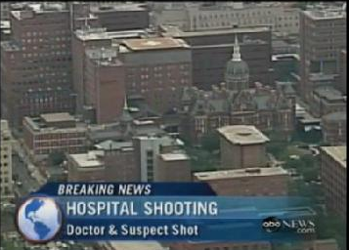
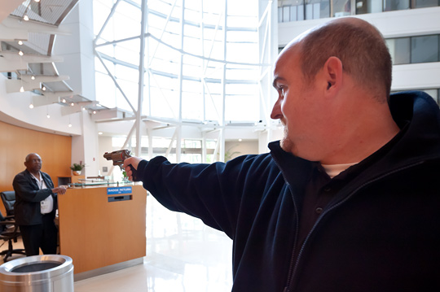
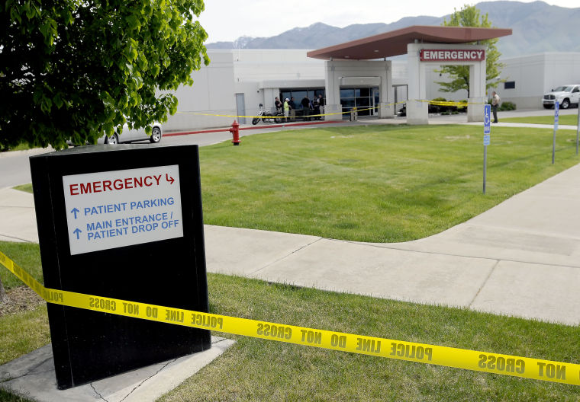
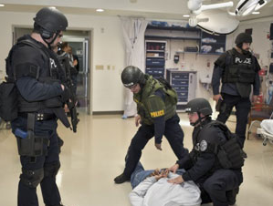
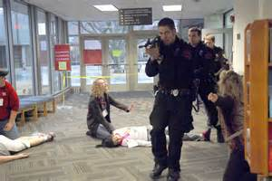

Notes:
“Unfortunately, the health care setting is not immune to workplace violence.5-11 The rate of assaults on health workers is 8 of 10,000 compared with 2 of 10,000 for private-sector industries.”
“An active shooter is defined by the U.S. Department of Homeland Security as ‘an individual actively engaged in killing or attempting to kill people in a conﬁned and populated area; in most cases, active shooters use ﬁrearm[s] and there is no pattern or method to their selection of victims.’
8

Slide 9
Shooting Versus Active Shooter
Event Characteristics | Active Shooter | Hospital-Based Shooting
Victim Selection | Random | Targeted
Progression | Unpredictable/ Evolves Quickly | Unpredictable/ Evolves Quickly
Response Opportunity | Yes | No
Event Termination | By Law Enforcement/ Armed Security | By Self
Casualties | Mass/Unlimited | Limited
Hostages | No | No
Notes:
Discuss the difference between hospital-based shooting and active shooter… not all shooting incidents are active shooter incidents! Active Shooter is very rare. Most are targeted shootings.

Slide 10
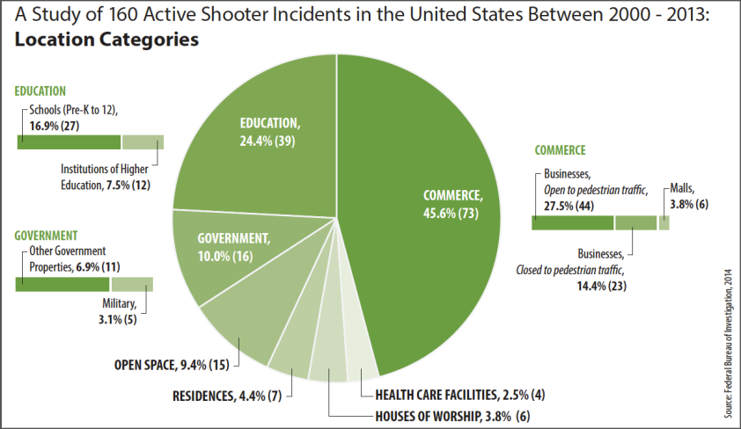
Active Shooter Incidents by Location
Notes:
What we do see in healthcare more accurately falls into other categories:
Murder / Suicide
Targeted gun violence
Domestic disputes that follow to the workplace
Hostage Situation
Aggravated robbery with a gun
Brandishing of a gun
Defined “Active Shooter” incidents have occurred a relatively small number of times in healthcare locations. 2.5% of all locations, per FBI Statistics; 4 total incidents 2000 to 2013 in hospital or healthcare setting).
http://www.fbi.gov/news/stories/2014/september/fbi-releases-study-on-active-shooter-incidents/pdfs/a-study-of-active-shooter-incidents-in-the-u.s.-between-2000-and-2013

Slide 11


Scenario
You hear shots from a nearby area.
You see people running through your area.
Notes:
[It would be helpful to have a map of the work areas participating in the exercise available for the participants to view.]

Slide 12
Question?
What plans and procedures are in place to respond to this type of event?
What are your initial actions for responding to this incident?
Notes:
Facilitate a discussion of the location of the Emergency Response Plan for Active Shooter and the actions listed in the plan.

Slide 13



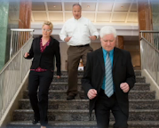
Part I: Run
What are the ways can you leave this area?
Where do they go?
Notes:
Ask: What are the ways to leave you work space? Encourage staff to think about pass-throughs and emergency exits. For areas not on a main floor include stairwells. [Have a printed floor map with the egress points already marked for reference. ]
If appropriate ask: How would your patient care role affect your decision making? What are the variables that would affect your response? Ambulatory versus non-ambulatory patient? Location of threat in proximity to you? Discuss these points. Address any concerns regarding patient abandonment. Note: The definition of patient abandonment does not include a care provider running to safety when his or her life is at risk.
Ask: Do you know where all your escape routes end up? Does the exit door go directly outside or into a corridor. If it’s a corridor do they turn left or right? Remind them it is unnerving to use an unknown route in a crisis especially, going down a unknown stairwell where you don’t know the exit point.
What is the process for relocating/evacuating staff, patients, and visitors? Who is authorized to initiate relocation/evacuation?

Slide 14

Question?
How are staff in the work area and facility notified of the incident?
  Who else do you need to notify?
  How are they notified?
Notes:
Lead a discussion of how word of the threat is shared with staff, visitors, and patients in the work area.
Emphasize to call on-site Security as soon as it is safe to do so (if available). For areas without 24/7 security in the facility they should notify law enforcement .

Slide 15

Question?
Who calls 911?
What information will the 911
operator need immediately?
What information will the community law enforcement officers need prior to arriving on scene?
Notes:
Discuss who should call 911. When in doubt if notification has been made, call. For areas with Mayo Clinic full-time security staff, the 911 call should be on a Mayo phone if possible. This activates other internal responses such as a plain language overhead announcement that will alert others to the threat.
Information to provide in the notification:
Type of emergency (e.g. Active Shooter).
Location- building, room, and area where the shooter was last known to be.
Description of the shooter and weapon, if known.
Number of injuries, if known.
Your name and a callback number where you can be reached.
How is the incident communicated to public safety agencies?
How is incident information communicated to staff in the work space and in the facility more broadly?
How is area “lockdown” communicated to staff in the work space and in the facility more broadly?
How is relocation/evacuation directives communicated to staff in the work space and in the facility more broadly?

Slide 16
Question?
If the shooter is not in the immediate vicinity…..
Could you secure your work area? the facility?
  If so, How?
Notes:
Discuss options to secure the work area and/or the facility if the shooter is not located in the immediate vicinity (when run is the best option).
Does the work area have a “lockdown” process? If yes, who can initiate the process?

Slide 17
Scenario - Continues
The man enters your work area waving a gun in the air.
As he approaches, he begins shooting those in the area.
Notes:
[It would be helpful to have a map of the work areas participating in the exercise available for the participants to view.]
Before you have a chance, to escape the area, the shooter enters your work area and starts shooting.

Slide 18
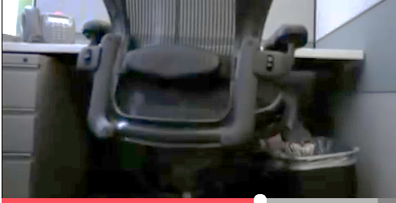
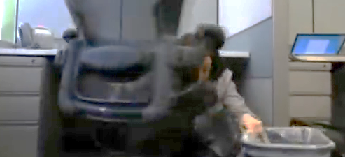
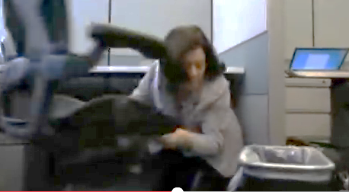
Part II/III: Hide/Fight
Where can you hide in your work area?
What items are readily available that can be used to defend yourself?
Notes:
Discuss what a person should look for in an ideal hide-out location.
Conceals you from view
Protects you from stray bullets (metal, thick, multiple layers)
Easily defendable
Offers escape route
Can be locked or barricaded
Accessible communication method (phone, computer)
Explain the difference between cover and concealment. Concealment is any object or structure that removes you from view. The threat/shooter cannot see you. Cover is an object that removes you from view and protects you from gunfire. Cover is less readily available. Drywall, wood doors, and framing lumber in walls are not cover. Cover is something that would stop a bullet.
What areas are lockable? In your work area where are the bathrooms, offices, storage rooms, closets, or other areas that you have immediate access to that you could lock yourself in during an emergency?
What areas could be barricaded? Does the door open into the room, or out into the hallway? Is there any furniture, printer, or other large object that could be pushed in front of the door to prevent it from opening?
Does your site have any lock-down technology or procedures? What type of access control technology exists at your site, if any? How does this factor into your response.
Remind them it is important to turn off lights and turn off cell phone/pager (vibration or light from a device can reveal a location).
Once hidden, don’t move until law enforcement arrives.

Slide 19
Questions?
What assistance will be provided by our Security staff?
Notes:
[Include local security response information here.]
What is the role of security in responding to an active shooter incident?

Slide 20

Questions?
What assistance can we expect to receive from our community first response partners?
Notes:
[Include local law enforcement response information here in case law enforcement does not attend the tabletop which is preferred.]
What is the role of public safety agencies (law enforcement, fire, EMS) in responding to an active shooter incident?

Slide 21
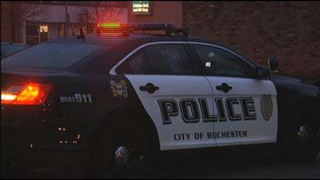
Question?
Where will law enforcement initially stage?
What does law enforcement expect of staff?
Notes:
[Include local law enforcement response information here in case law enforcement does not attend the tabletop which is preferred.]
Have law enforcement discuss expectations including:
Follow any directions given quickly without question.
Keep your hands visible and open with spread fingers
Don’t make sudden movements
Don’t point with one finger or scream

Slide 22

Scenario - Continues
Law enforcement ask you where your staff are located that evacuated from the building/area.
They want to know who is still in the building/area.
Notes:
Discuss accounting for staff after evacuation/relocation.
Do you have a way to account for staff once they have left the area?

Slide 23
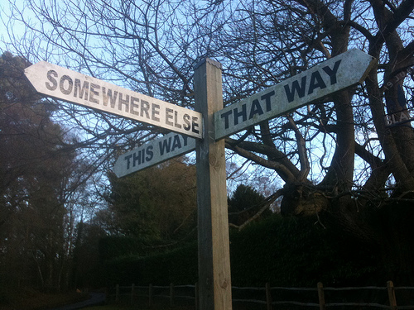
Scenario Continues
Additional gunshots are reported in area.
There are reports that the shooter moving to other areas in the building.
There multiple victims in the area/building.

Slide 24
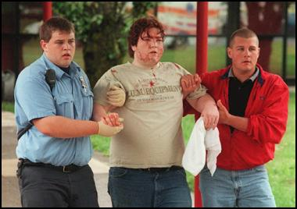
Question?
How will victims be managed?
  Who is responsible?
Notes:
Remind staff that until the area is declared safe by law enforcement, staff should not enter the area. Safety of the caregivers need to come first.
Will hospital staff care for the wounded or will EMS come into the area to triage and stabilize the victims?
What if the victims are co-workers?

Slide 25
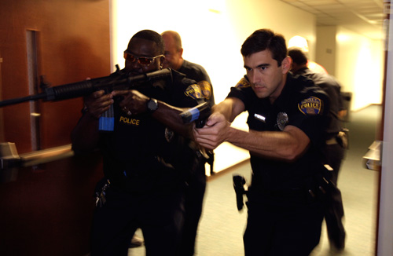
Scenario
Law Enforcement reports the shooter has been subdued.

Slide 26

Question?
What operational impact would this scenario have on your work area?
Do you have a continuity plan if you cannot occupy your work area for a period of time?
Notes:
The work area may declared to be a crime scene and off-limits for a period of time.
How would/could the essential function be reestablished in another area?
How is the staff behavioral health aspect of an active shooter incident managed?
What is the continuity plan for the work area if the work space cannot be occupied for a period of time following an active shooter incident?
How long is a work area expected to be closed following an active shooter incident?
Who identifies when the active shooter situation transitions from response to recovery? (Who issues the “active shooter” all clear?)

Slide 27

Question?
How would staff be kept informed about the evolving situation? How will you know what to tell staff?
How would you be communicating with the family members?
Notes:
Discuss communication methods for the following:
Staff is sheltering-in-place under lockdown.
Staff evacuated the area.
How will law enforcement let you know when the area is safe to return? How will you identify and make available to law enforcement any staff that may have pertinent information to provide.
Who would communicate to family members if a staff member is injured during the incident?

Slide 28

Question?
What recovery procedures would
need to be initiated at this time?
How would you re-establish your functions in the work area?
How would staff emotionally process what happened? How could the work area support staff affected by the incident?
Notes:
Discuss continuity planning and putting back together the work flow of the area such as:
Rescheduling appointments
Reassessing what was done and not done
Emotionally processing the incident
Ensure that resources are mentioned that are available to assist staff with processing the incident:
Behavioral Health Teams
Employee Assistance Program (http://intranet.mayo.edu/charlie/employee-assistance-rst/)
Chaplains

Slide 29
Any other questions or discussion?

Slide 30
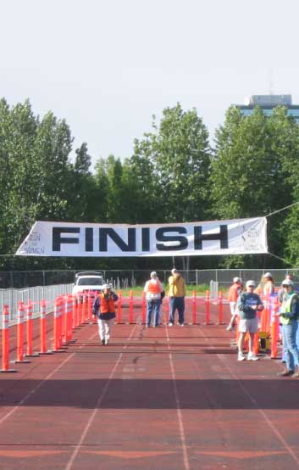
Player Debrief/Wrap Up
Player Comments
  Strengths
  Opportunities
Complete your notes
  Take with you
Participant Feedback Forms
  Turn in to Facilitator
Notes:
Debrief: Do a roundtable and ask participants to highlight what they learned that “we” do well. What is an area of improvement that stood out?
Please take the time to provide your comments on the participant feedback form so we can collect strengths and areas for improvement that you identified from your perspective from the exercise today.
30

Slide 31
Additional Resources
Department of Homeland Security
  Active Shooter Preparedness website
Federal Bureau of Investigation
  Active Shooter Planning and Response in a Healthcare Setting

Slide 32

Notes:
32
These are extreme circumstances for a statistically rare type of incident. Your chances of being involved in an active shooter event is very, very low. But it is worth the critical thinking exercise because the impact and danger level of an event is very high. Sadly, we have seen these events occur in locations where most people previously believed that such an event would never happen.
A basic level of education and preparedness, in the form of training slides and practical exercises, is a reasonable and prudent response to these rare but highly critical events.
Thank you for your participation in this training and your support of our safety and security efforts. Your continued partnership and attention to these matters is the foundation of our effective Security program at our facility, and ultimately, supports the best service to our patients.
Thank you. Does anyone have any last minute questions?

