Slide 1
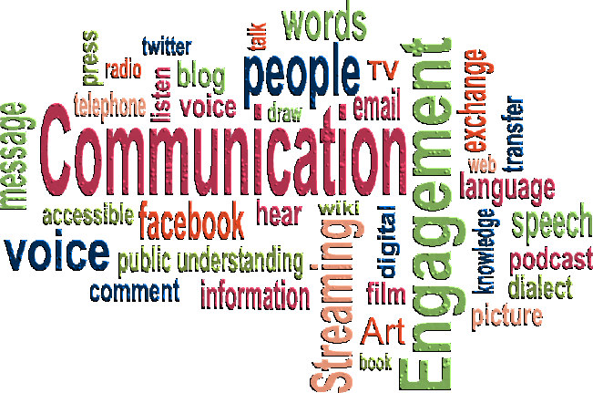
Health care Emergency Communication plan
Shawn E Stoen
West Central MN Healthcare
Preparedness Coalition
Regional Healthcare Preparedness Coordinator

Slide 2
Objectives
Identify the components of the emergency plan that are required by CMS
Identify hints on building or developing your communications plan
Identify eight things your emergency plan should do
Understand the components necessary in a communications plan
Define HIPAA and its implications on emergency communication situations
Understand how HICS, communications, and the PIO work together
Discuss the role of communications in an emergency

Slide 3
CMS and Communication Plans
Requires health care facilities have a stand alone communications plan that:
Includes names and contact information for:
Staff
Contracted agencies that conduct business within the facility (i.e. rehab services, beauty salon)
Physicians
Neighboring health care agencies (i.e. hospitals, clinics, long term care agencies)
County contacts (public health, law enforcement, fire, emergency medical services, mortuary)
Regional contacts (health care coalition)
State contacts (licensing agencies,
Volunteers

Slide 4
CMS requirements continued……
Identifies how to contact staff and other contacts….
To include the primary and back up processes
Who to contact and when to contact people/resources
Identifies how to release information to health care providers in the event of an evacuation
Discusses how to release information about the patients basic condition and location
A process for sharing the long term facilities status, including occupancy, ability to provide services to local emergency management, county partners, health care coalition, and state agencies
Identify how to update patients/families/responsible parties the status of the facility and the emergency plans that are in place/being utilized

Slide 5
Hints on developing your communication plan
Keep it simple
Be flexible
Easily accessible
Coordinate with other entities (local emergency management, law enforcement)
Review, test and practice
Utilize the Healthcare Incident Command System – Public Information Officer

Slide 6
8 things your communications plan should do:
Launch quickly.
Brief leadership/management on the situation.
Identify the facilities Public Information Officer and their role in an emergency.
Processes that identify how to prepare and issue statements to the media and other organizations.
Organize, monitor, and facilitate media coverage including social media.
Communicate situation information and procedural instructions to employees and other stakeholders.
Communicate with employee/patient families and the local community.
Continually adapt to changing events associated with the emergency.

Slide 7
Components of a Communications Plan
Identify the types of communications available within your facility and how they will be used in the communications plan
Types of communications (radio, phone, computer, overhead paging)
Plain language – overhead paging
Who are the stakeholders and how to contact them and when to contact them
How to communicate with family members in an emergency
How to maintain contact lists, who is responsible for maintaining, how to use contact lists
Information sharing
With media
Family
Patients
Stakeholders/County/Region/State
Notes:
The communication plan should discuss the options available for communications and how they would be used in the emergency plans. For example – Evacuation plan and communications – how to notify family members where/when evacuation is taking place, or infectious disease situation limiting visitors (how to share that information with family ahead of time).
Plain language – it is encouraged that facilities adopt plain language in overhead paging and in emergency plans. Imagine if Code Black is a bomb threat for one facility and a tornado warning for another facility – if you have an employee that works at both – they may evacuate to the outside when a tornado is coming…..plain language eliminates confusion, is transparent and visitors/patients will know what is happening.
Not only should the plan have appendixes to the contact lists – it should also reference who maintains, how updated, how contacted, and when contacted

Slide 8
HIPAA in emergencies
HIPAA is designed to protect the patients rights to privacy however, it is also flexible enough to ensure that the community’s health is also protected
Information may be disclosed that ensures continued treatment – between health care providers
To public health agencies, MDH, CDC – when the information is used to protect or control the spread of disease to community members, EMS or first responders etc.
Imminent Danger – information can be disclosed to law enforcement/emergency management/fire departments and first responders - to identify location of a person at risk/needing assistance

Slide 9
Notes:
US Department of Health and Human Services developed a decision tool to help make a decision if information can be released.

Slide 10
Hics and communications
Have someone with Public Information Officer training (online, Anniston, regional)
Utilize the job action sheets which identify responsibilities of the PIO
Works with other PIO’s in the event to create one consistent message
Create pre-scripted releases for media
Monitors media
Develop a working relationship with stakeholders, media, and emergency management

Slide 11
What the communications section and public information officer will need……
Telephones with dedicated or addressable lines for incoming calls and separate lines for outgoing calls
Access to any electronic notification system used to inform employees
Electronic mail (with access to “info@” inbox and ability to send messages)
Fax machine (one for receiving and one for sending)
Webmaster access to company website to post updates
Access to social media accounts
Access to local area network, secure remote server, message template library and printers

Slide 12
What the PIO/Communications Center needs continued……..
Hard copies of emergency response, business continuity and crisis communications plan
Site and building diagrams, information related to business processes and loss prevention programs (e.g., safety and health, property loss prevention, physical and information/cyber security, fleet safety, environmental management and product quality)
Copiers
Forms for documenting events as they unfold
Message boards (flipcharts, white boards, etc.)
Pens, pencils, paper, clipboards and other stationery supplies

Slide 13
Communication during an emergency
Gather information
Monitor incoming calls
Coordinate messages
Monitor email/media/social media
Keep management/incident command updated on the situation
Provide/share information with patients, staff, families, community, law enforcement, media etc.
Notes:
There is a lot of information involved in communication planning. Utilize the tools available on the Regional website and feel free to contact our regional coordinator – either Don or myself. We are more than willing to assist in the process.

Slide 14
Questions?

