Slide 1
Red Lake Hospital Highly Contagious Patient PPE Donning and Doffing Training
Meeting the needs of our community as trained, qualified, and confident healthcare workers.

Slide 2
Glossary of Abbreviations
TO: Trained Observer
ABHC: Alcohol Based Hand Cleaner
HCP: health care provider (this includes anyone in contact with the patient or room)
PPE: Personal Protective Equipment

Slide 3
Cleaning
Trained Observer (TO) in clean area with checklist for donning observes process and reads aloud steps.

Slide 4
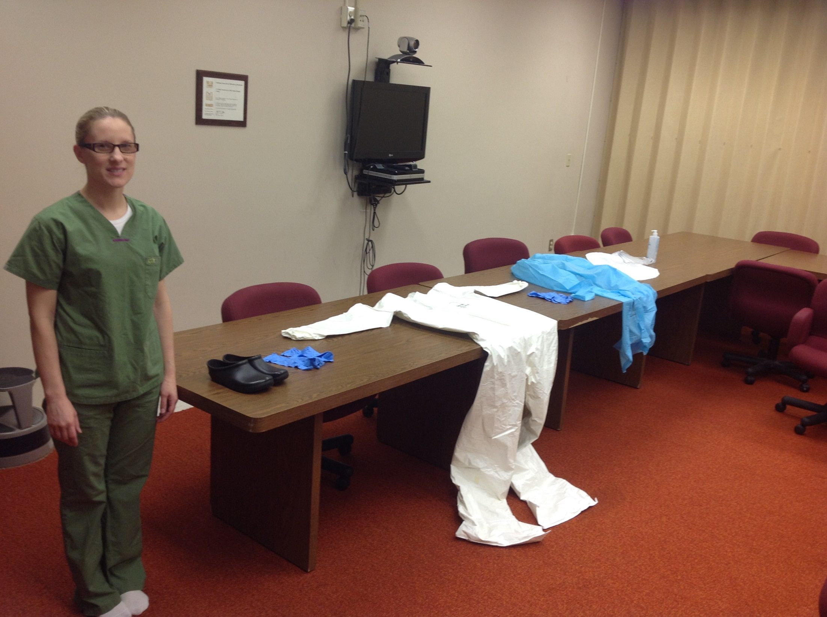

Slide 5
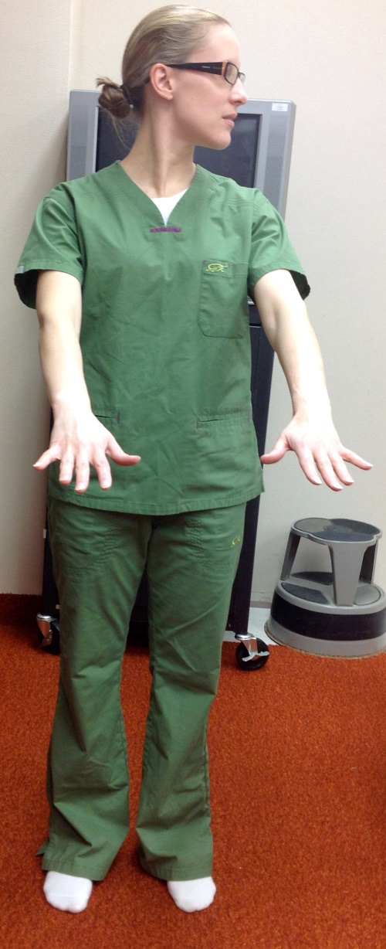
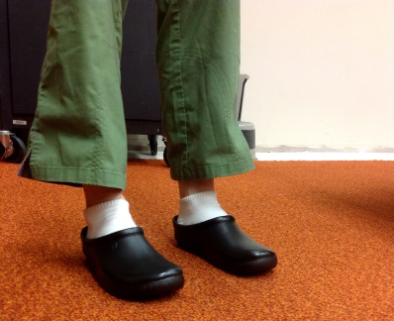
HCP Preparation
Before donning HCP will remove all personal times and change into hospital scrubs, hospital socks, and washable hospital footwear.
Ensure long hair is up on head and confined with disposable hair items and/or hairnet.
Remove all jewelry
Put on rubber shoes
Use restroom prior to donning.

Slide 6
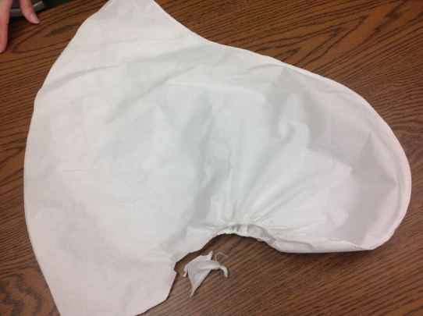
Prepare PPE
Select proper sizes of PPE
Inspect for serviceability by TO and HCP.
Modifications:
Surgical Hood: Cut a V out of lower portion of hood’s face opening to allow for glasses, improved visual field, and superior face shield placement

Slide 7
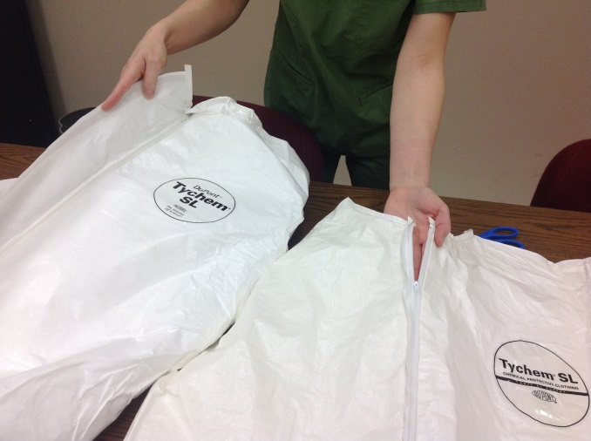
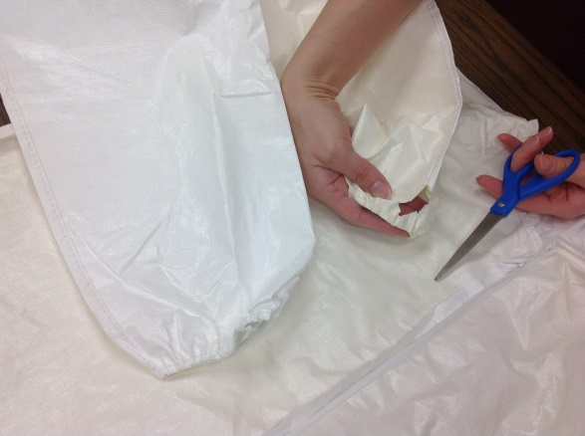
Tyvek coverall preparation
Select proper size coverall suit
Cut hood off the suit
Cut zipper flap from suit
Cut thumb holes just before cuff end (approximately 1 inch hole).

Slide 8
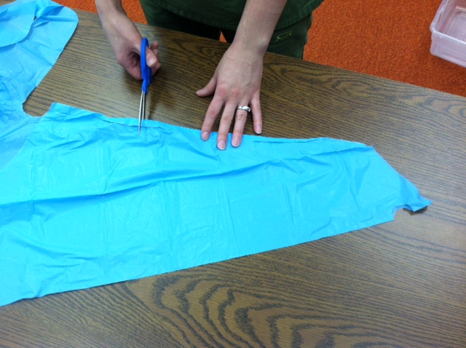
Prepare Apron
Remove sleeve at elbow area

Slide 9
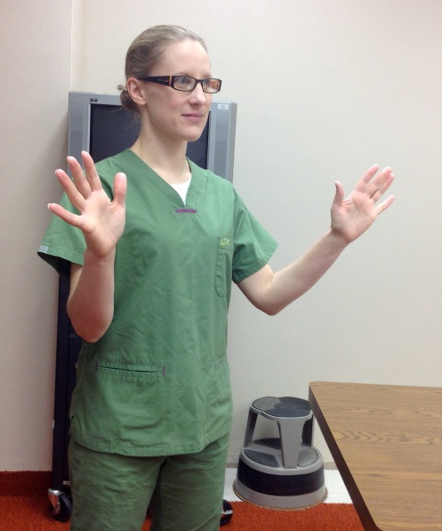
Perform hand hygiene
Perform hand hygiene with Alcohol Based Hand Cleaner (ABHC) and allow to air dry.

Slide 10
Put on Gloves
Put on inner gloves with extended cuffs preferably dark gloves are used as inner gloves.
Gloves of different colors can assist the HCP and TO in identifying tears and possible exposure risk.

Slide 11
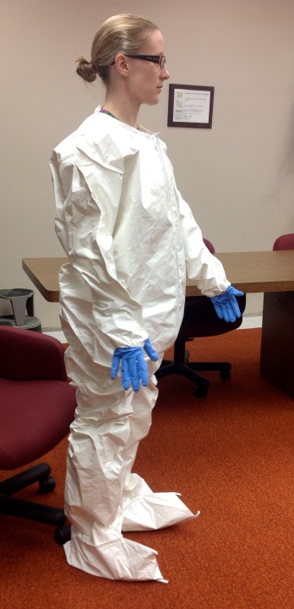
Put on Coveralls
Put on coveralls with gloved thumbs into thumb loops to ensure extended cuffs are under sleeves.

Slide 12
Ensure Comfort and Freedom of Movement
Ensure coveralls are large enough to allow freedom of movement.

Slide 13
Put on Outer Glove
Put on outer glove (second pair) with extended cuffs over sleeves of coverall using lighter colored gloves if available.

Slide 14
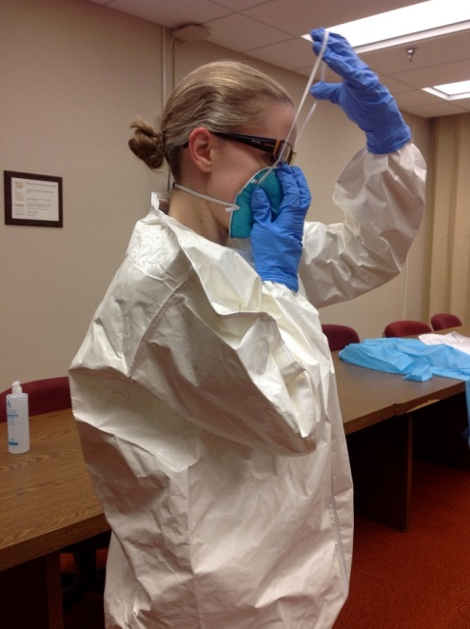
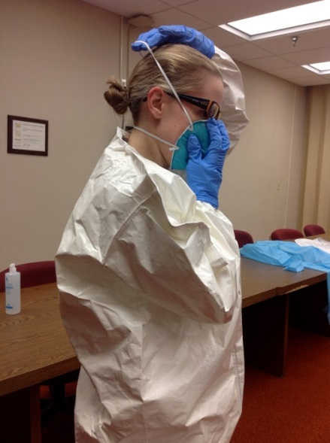
Put on Mask
Put on proper fitting N95 mask.
Crimp around nasal bone.
Perform seal test by covering mask completely with both hands and exhaling sharply. If air blows into your face or eyes, readjust the mask

Slide 15
Put on Outer Apron
Don surgical apron. TO can assist tying apron behind back of HCP.

Slide 16
Put on Surgical Hood
Put on surgical hood that covers all hair and extends past neck onto shoulders.

Slide 17
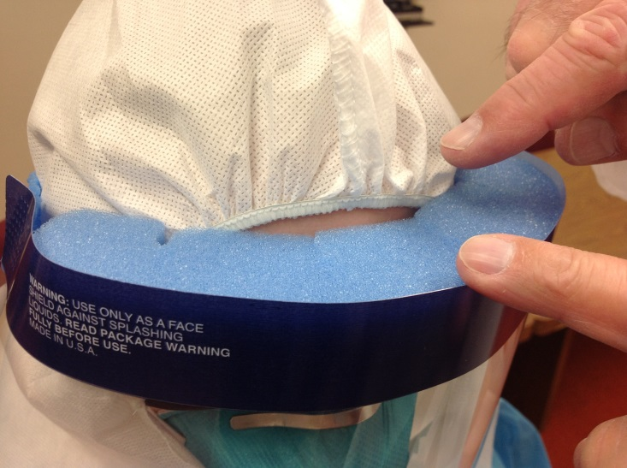
Put on face shield
Don face shield
Make sure that the shield covers the hood opening and that the hairline is completely covered.

Slide 18
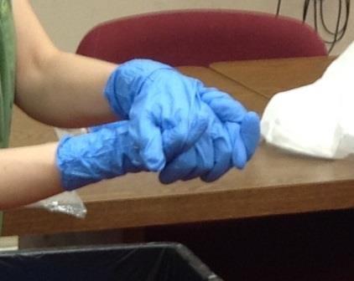
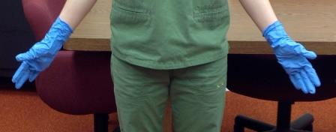
Disinfect Gloves
Disinfect outer gloves using Alcohol Based Hand Cleaner (ABHC)
Distribute
Allow to air dry

Slide 19
Donning Complete!
You’re off!
HCP can enter high risk work area

Slide 20
Trained Observer Role
PPE inspection
TO will verify donning and doffing process
TO will log time HCP enters high risk work area and remind HCP when to leave work area, approximately one hour.

Slide 21
Doffing Procedure

Slide 22
Enter the designated doffing area
HCP will enter designated doffing area
Engaged Trained Observer (TO) in Personal Protective Equipment (PPE) who reads aloud each step of PPE removal, confirming each step visually that step has been performed properly before progressing to the next step. TO confirms the entire PPE removal process.

Slide 23
Get Ready to Doff
TO will remind HCP to avoid reflex actions that can put them at risk of contamination such as touching face and hair.
TO will inspect PPE for visible contamination cuts, tears, other before starting removal. If contamination is discovered, disinfect with EPA registered disinfectant wipes.

Slide 24
Disinfect Gloves
Disinfect outer gloves using Alcohol Based Hand Cleaner (ABHC)
Distribute
Allow to air dry

Slide 25
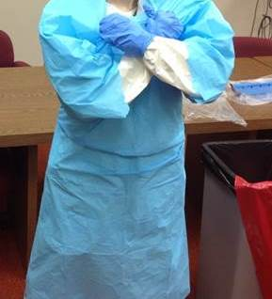
Remove Apron
Remove apron using cross arm method
Discard into properly marked container.

Slide 26
Disinfect Gloves
Disinfect outer gloves using Alcohol Based Hand Cleaner (ABHC)
Distribute
Allow to air dry

Slide 27
Remove Outer Gloves
Remove outer gloves and dispose of in properly marked container. LEAVE INNER GLOVE ON!
HCP inspect for cuts or tears on inner gloves and disinfect with ABHC and air dry.

Slide 28
Don a New Pair of Gloves
Disinfect outer gloves using Alcohol Based Hand Cleaner (ABHC)
Distribute
Allow to air dry

Slide 29
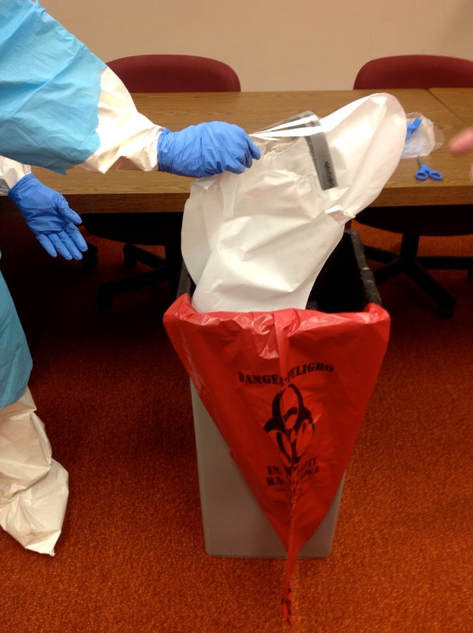
Remove Hood and Face shield
Remove face shield and hood at same time by pinching outside of plastic shield lifting forward and up while reaching to top of hood grasping the peak and pulling forward and up to remove shield and hood.
It may be necessary to tilt head forward during removal.
Once hood and shield are removed, discard into properly marked container.

Slide 30
Disinfect Gloves
Disinfect outer gloves using Alcohol Based Hand Cleaner (ABHC)
Distribute
Allow to air dry

Slide 31
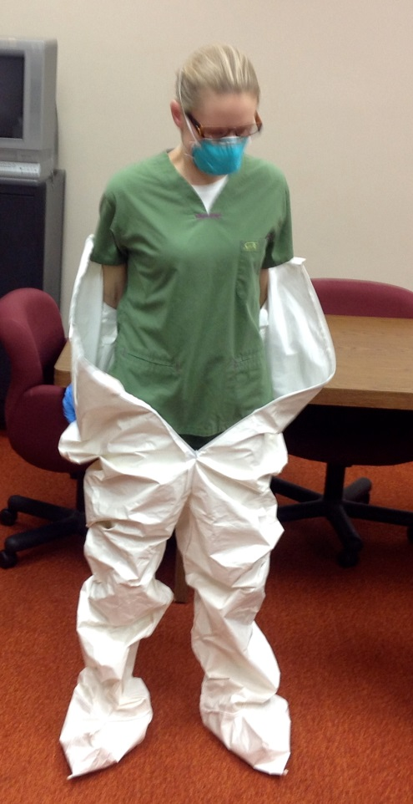
Remove Coverall
HCP unfastens/unzips coverall.
HCP removes coverall in a rolling fashion and stops immediately at foot level.
Outer gloves are removed with the rolling removal of the coverall and will stay with the coverall.

Slide 32
Disinfect Gloves
Disinfect inner gloves using Alcohol Based Hand Cleaner (ABHC)
Allow to air dry

Slide 33
Remove Feet from Coverall
HCP will remove each foot from the coverall maintaining shoe on foot (if possible). Step on the clean inside of the coverall.
IF shoe stays behind in coverall, reach in with cleaned gloves and remove shoe.
Be careful to avoid touching the outside of the coverall.

Slide 34
Disinfect Gloves
Disinfect inner gloves using Alcohol Based Hand Cleaner (ABHC)
Allow to air dry

Slide 35
Step Off Coverall
HCP steps off coverall
Carefully pick up coverall and discard into properly marked container.

Slide 36
Disinfect Gloves
Disinfect inner gloves using Alcohol Based Hand Cleaner (ABHC)
Allow to air dry

Slide 37
Shoe Bath-time
Step into shoe bath solution of 5 parts water to one part bleach solution.
Shuffle shoes in solution bath.
Step into clean area on the disposable absorbing cloth (Chux).
Step out of shoes onto clean floor.
Dirty Side
Clean Side

Slide 38
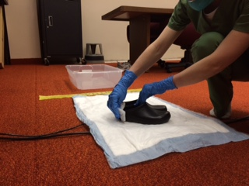
Clean Shoes
Don clean gloves and pick up shoes cleaning them thoroughly with ABHC/EPA registered Disinfectant Wipe.
Then place the shoes in designated area to allow air drying.
Pick up disposable absorbing cloth and place in properly marked container.
Clean Side

Slide 39
Disinfect Gloves
Disinfect inner gloves using Alcohol Based Hand Cleaner (ABHC)
Allow to air dry

Slide 40
Remove N-95
Remove N95 mask by grasping front of mask and remove by pulling forward and up. Be careful of hair nets and hair confining objects.
Discard in properly marked container.

Slide 41
Disinfect & Remove Gloves
Disinfect inner gloves using Alcohol Based Hand Cleaner (ABHC)
Allow to air dry
Remove gloves and place in properly marked container.

Slide 42
Disinfect Hands
Disinfect gloves with ABHC and allow to air dry. Remove gloves and place in properly marked container. Disinfect hands with ABHC and allow to air dry.

Slide 43
Final Review by TO
TO inspects HCP in clean doffing area for any contamination. Any contamination discovered is disinfected.
TO immediately notifies safety officer and infection preventionist IF THERE IS ANY CONTANIMATION before HCP leaves doffing clean area.

Slide 44
Shower
HCP removes hospital scrubs and socks, showers, and dons clean scrubs, socks, and shoes.
At end of each shift HCP to shower if HCP performed high risk patient care or housekeeping duties in high risk areas.

